Slide 1
CS3391 Object Oriented Programming
Dr.D.Sivaganesan, Professor,
PSGiTech / CSE

Slide 2
STRINGS IN JAVA
In java, string is basically an object that represents sequence of char values. Java String provides a lot of concepts that can be performed on a string such as compare, concat, equals, split, length, replace, compareTo, intern, substring etc.
In java, string objects are immutable. Immutable simply means unmodifiable or unchangeable. String s="java";
There are two ways to create String object:
By string literal
By new keyword
1 ) String Literal
Java String literal is created by using double quotes. For Example:
String s="welcome";
2) By new keyword
String s=new String("Welcome");

Slide 3
char charAt(int index) | returns char value for the particular index
int length() | returns string length
static String format(String format, | returns formatted string
Object... args)
static String format(Locale l, String | returns formatted string with given locale
format, Object... args)
String substring(int beginIndex) | returns substring for given begin index
String substring(int beginIndex, int endIndex) | returns substring for given begin index and end
 | index
boolean contains(CharSequence s) | returns true or false after matching the sequence of char value
boolean equals(Object another) | checks the equality of string with object
boolean isEmpty() | checks if string is empty
String concat(String str) | concatinates specified string
String replace(char old, char new) | replaces all occurrences of specified char value

Slide 4
static String equalsIgnoreCase(String | compares another string. It doesn't check case.
another)
String[] split(String regex) | returns splitted string matching regex
String[] split(String regex, int limit) | returns splitted string matching regex and limit
String intern() | returns interned string
int indexOf(int ch) | returns specified char value index
int indexOf(int ch, int fromIndex) | returns specified char value index starting with given index
int indexOf(String substring) | returns specified substring index
int indexOf(String substring, int fromIndex) | returns specified substring index starting with
 | given index
String toLowerCase() | returns string in lowercase.
String toLowerCase(Locale l) | returns string in lowercase using specified locale.
String toUpperCase() | returns string in uppercase.
String toUpperCase(Locale l) | returns string in uppercase using specified locale.
String trim() | removes beginning and ending spaces of this string.
static String valueOf(int value) | converts given type into string. It is overloaded.

Slide 5
public class exstrings {
public static void main(String[] args) {
String targetString = "Java is fun to learn";
String s1= "JAVA";
String s2= "Java";
String s3 = " Hello Java ";
System.out.println("Char at index 2(third position): " + targetString.charAt(2));
System.out.println("After Concat: "+ targetString.concat("-Enjoy-"));
System.out.println("Checking equals ignoring case: " +s2.equalsIgnoreCase(s1));
System.out.println("Checking equals with case: " +s2.equals(s1));
System.out.println("Checking Length: "+ targetString.length());
System.out.println("Replace function: "+ targetString.replace("fun", "easy"));
System.out.println("SubString of targetString: "+ targetString.substring(8));
System.out.println("SubString of targetString: "+ targetString.substring(8, 12));
System.out.println("Converting to lower case: "+ targetString.toLowerCase());
System.out.println("Converting to upper case: "+ targetString.toUpperCase());
System.out.println("Triming string: " + s3.trim());
System.out.println("searching s1 in targetString: " + targetString.contains(s1));
System.out.println("searching s2 in targetString: " + targetString.contains(s2));

Slide 6
char [] charArray = s2.toCharArray();
System.out.println("Size of char array: " + charArray.length);
System.out.println("Printing last element of array: " + charArray[3]);
String str = "Veg is good for health :A Computer Science Portal";
String[] arrOfStr = str.split(":");
for (String a : arrOfStr)
System.out.println(a);
System.out.println("Returning words:");
String[] arr = str.split("e", 5);
for (String w : arr) {
System.out.println(w);
}
boolean b1=s3.startsWith(" Hello");
boolean b2=s3.endsWith("a ");
System.out.println(b1); //output is true.
System.out.println(b2); //output is true.
String st="this is index of example";
//passing substring

Slide 7
int index1=st.indexOf("is");//returns the index of is substring
System.out.println(index1);
int index3=st.indexOf("is",4);//returns the index of is substring after 4th index
System.out.println(index3);//5 i.e. the index of another is
int index4=st.indexOf('s');//returns the index of s char value
System.out.println(index4);//3
int index5 = st.indexOf("method"); //Returns the index of this substring
System.out.println("index of substring "+index5);
int index6 = st.indexOf("method", 10); //Returns the index of this substring
System.out.println("index of substring "+index6);
int index8 = st.indexOf("method", 20); // It returns -1 if substring does not found
System.out.println("index of substring "+index8);
int index7 = st.indexOf('e', 12); //Returns the index of this char
System.out.println("index of char "+index7);
String reverse="";
String s5=new String("JAVA ");
int length = s5.length();
for (int i = length - 1 ; i >= 0 ; i--)
reverse = reverse + s5.charAt(i);
System.out.println("String reverse :"+reverse);
String str1 = new String("hello javaprogram ");
char[] ch = new char[10];
str1.getChars(6, 16, ch, 0);
System.out.println("Copied Chars");
System.out.println(ch);
}}

Slide 8
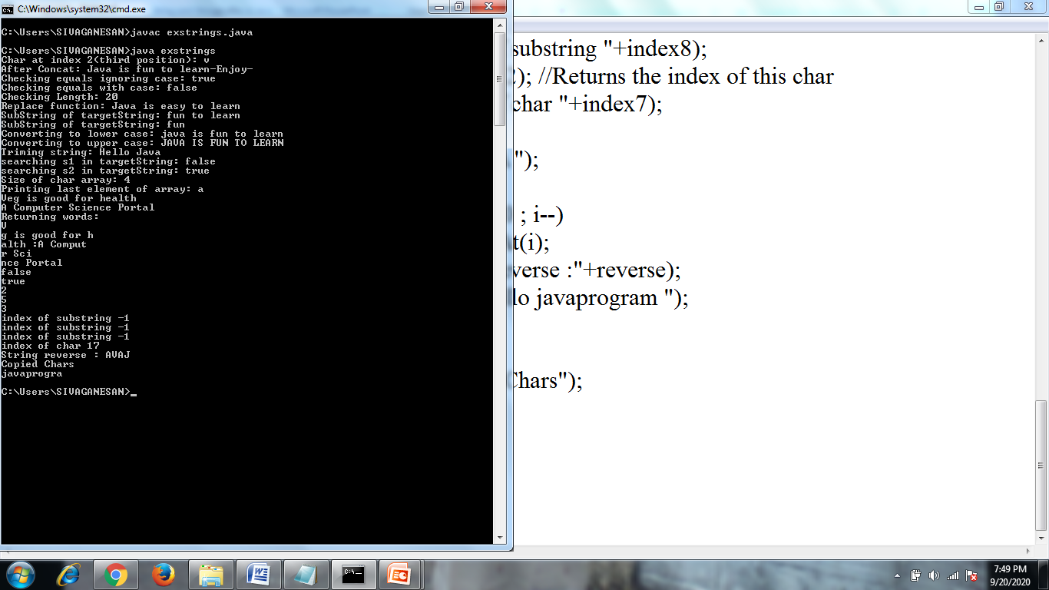

Slide 9
Java StringBuffer class
Java StringBuffer class is used to create mutable (modifiable) string. The StringBuffer class in java is same as String class except it is mutable i.e. it can be changed.
Constructor | Description
StringBuffer() | creates an empty string buffer with the initial capacity of 16.
StringBuffer(String str) | creates a string buffer with the specified string.
StringBuffer(int capacity) | creates an empty string buffer with the specified capacity as length.

Slide 10
Method | Description
append(String s) | is used to append the specified string with this string. The append() method is overloaded like append(char), append(boolean), append(int), append(float), append(double) etc.
insert(int offset, String s) | is used to insert the specified string with this string at the specified position. The insert() method is overloaded like insert(int, char), insert(int, boolean), insert(int, int), insert(int, float), insert(int, double) etc.
replace(int startIndex, int endIndex, String str) | is used to replace the string from specified startIndex and endIndex.
delete(int startIndex, int endIndex) | is used to delete the string from specified startIndex and endIndex.
reverse() | is used to reverse the string.
capacity() | is used to return the current capacity.
ensureCapacity(int minimumCapacity) | is used to ensure the capacity at least equal to the given minimum.
charAt(int index) | is used to return the character at the specified position.
length() | is used to return the length of the string i.e. total number of characters.
setLength() | is used to set the length of the string

Slide 11
public class exstringbuffer { public static void main(String[] args) { StringBuffer sb=new StringBuffer("Hello "); StringBuffer s1=new StringBuffer("Good Luck"); sb.append("Java"); System.out.println("Append :"+sb); sb.insert(1,"Java"); System.out.println("Insert :"+sb); sb.replace(1,3,"Java"); System.out.println("replace :"+sb); sb.delete(1,3); System.out.println("Delete:"+sb); sb.deleteCharAt(2); System.out.println("Delete at location 2:"+sb); System.out.println("Capacity :"+sb.capacity()); sb.ensureCapacity(25); System.out.println("Ensurecapacity :"+sb.capacity()); System.out.println("String length = "+ s1.length() +" and contains = " + s1); s1.setLength(6); System.out.println("After setLength() String = "+ s1.toString()); s1.reverse(); System.out.println("Reverse:"+s1); } }

Slide 12
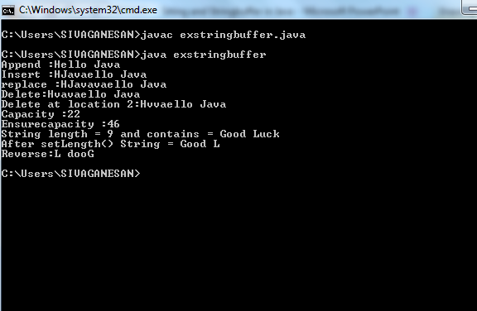

Slide 13
Thank you

